Slide 2
ENGLISH AS A FOREIGN LANGUAGE
UNIT 10 WORK OF ART
LESSON 1
Prof. Vera Freitas www.verafreitas.com
Instagram: @verafreitaslanguagecoaching

Slide 3
VISUAL 2 MINUTE MINDFULNESS MEDITATION

Slide 4
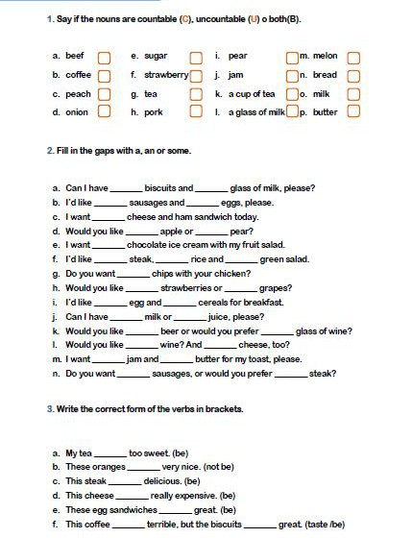

Slide 5
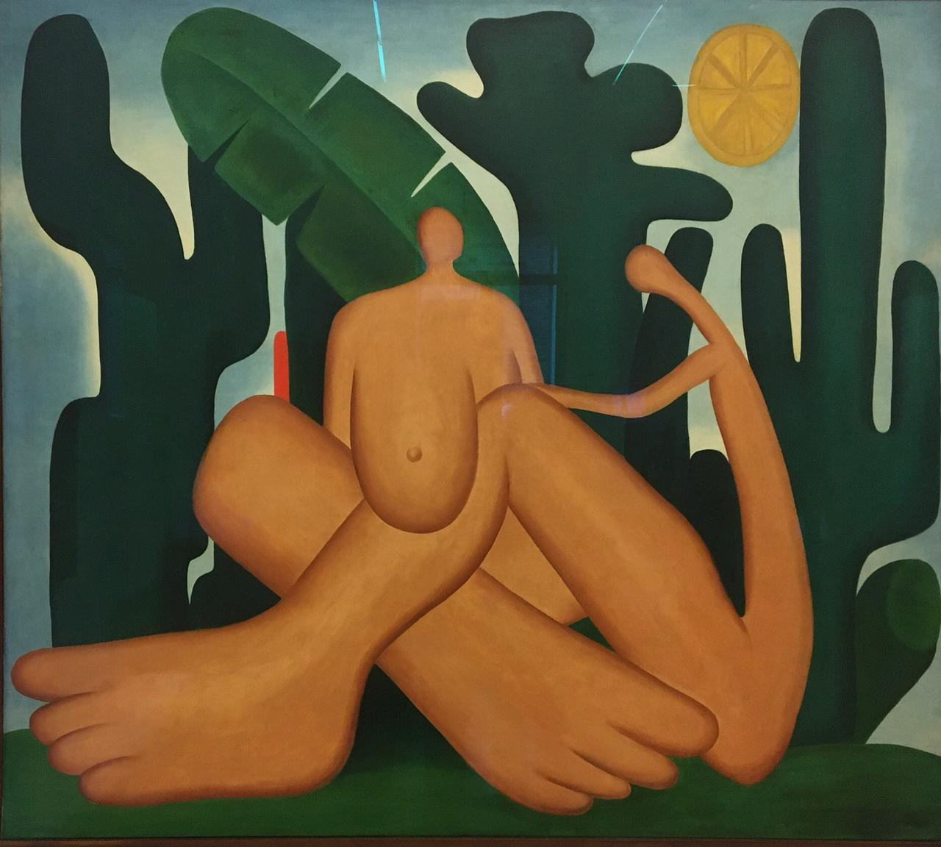
A WORK OF ART OR A MASTERPIECE?
ANTROPOFAGIA – TARSILA DO AMARAL

Slide 6
Noun
art
UK /ɑːt/ US /ɑːrt/
art noun (EXPRESSION)
A2 [ U ] the making of objects, images, music, etc. that are beautiful or that express feelings:
Can television and pop music really be considered art? I enjoyed the ballet, but it wasn't really great art.
https://dictionary.cambridge.org/

Slide 7
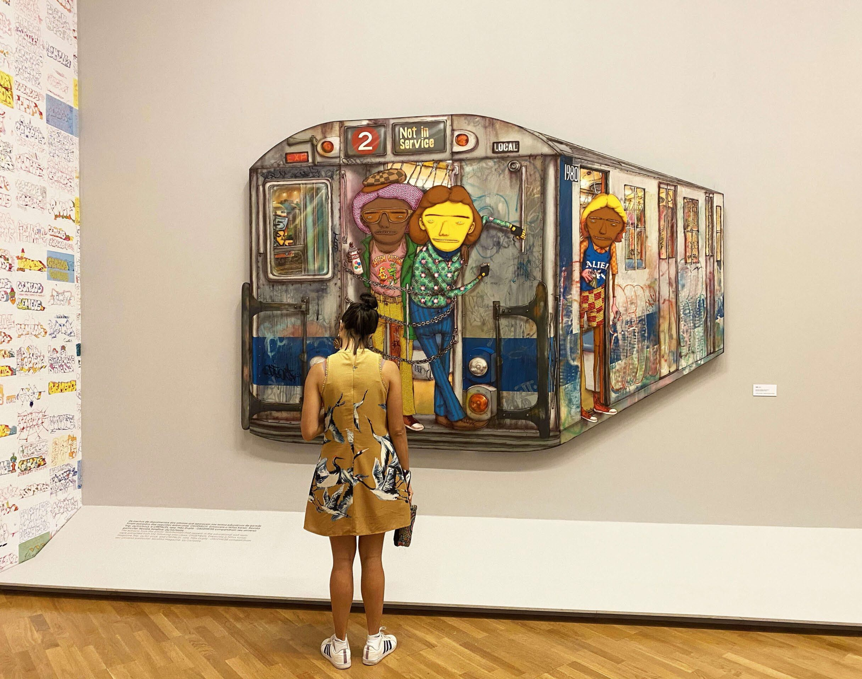
WHAT IS ART?
Art, in a broad sense, is a form of communication. It means whatever the artist intends it to mean, and this meaning is shaped by the materials, techniques, and forms it uses, and the ideas and feelings it creates in its viewers.
Art is an act of expressing feelings, thoughts and observations.
Art is also an expression of emotions, intuitions, and desires, but it is even more personal than that: it’s about sharing the way we experience the world.

Slide 8
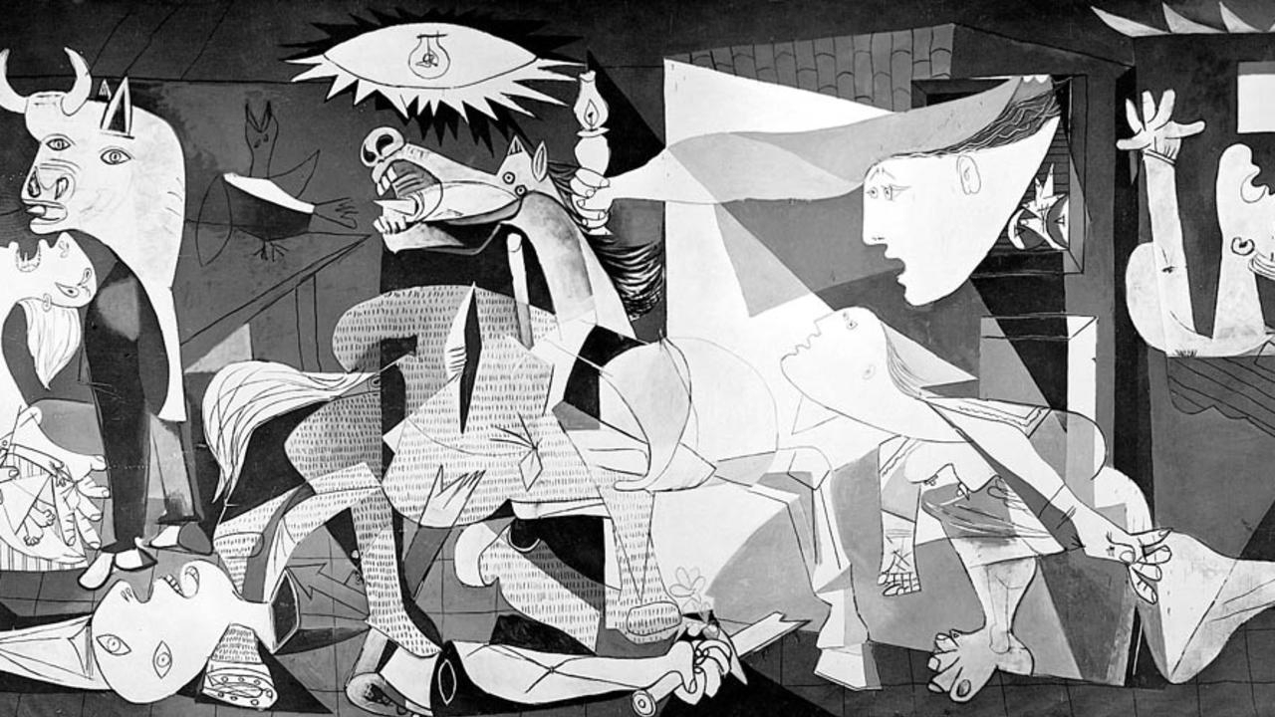
IS ART ALWAYS BEAUTIFUL?
GUERNICA – PABLO PICASSO

Slide 9
“BEAUTY IS IN THE EYE OF THE BEHOLDER”
GREEK PROVERB

Slide 10
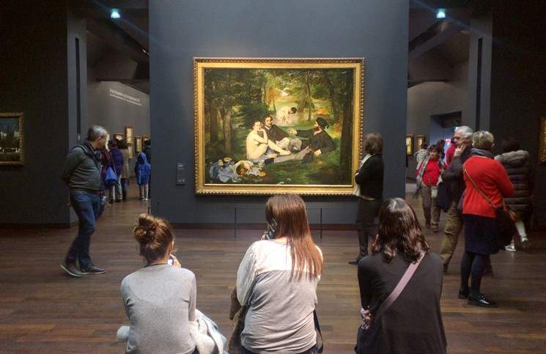
PAINTING
(CANVAS)

Slide 11
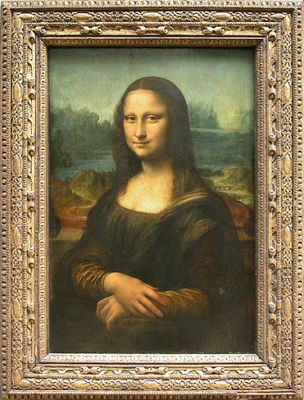
PORTRAIT
MONA LISA – LEONARDO DA VINCI

Slide 12
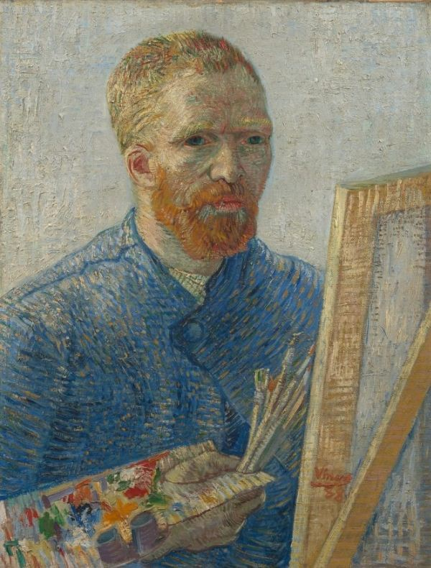
SELF-PORTRAIT
VAN GOGH

Slide 13
WATERCOLOUR

Slide 14
POSTER

Slide 15
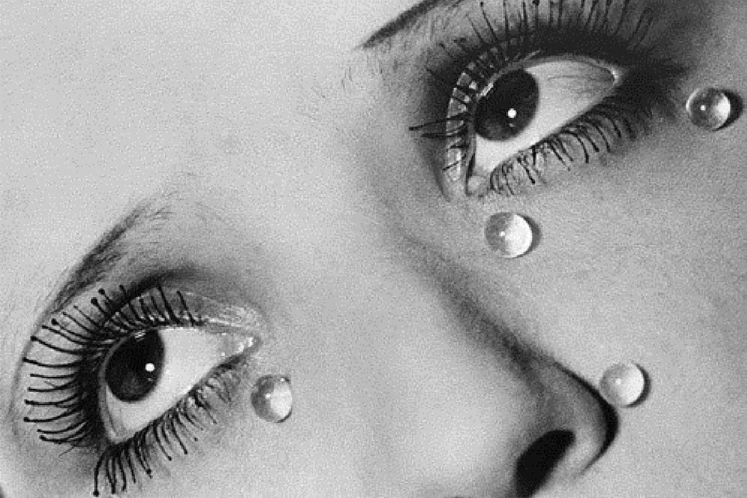
PHOTOGRAPHY
(ART)
PHOTOGRAPH = SNAPSHOT

Slide 16
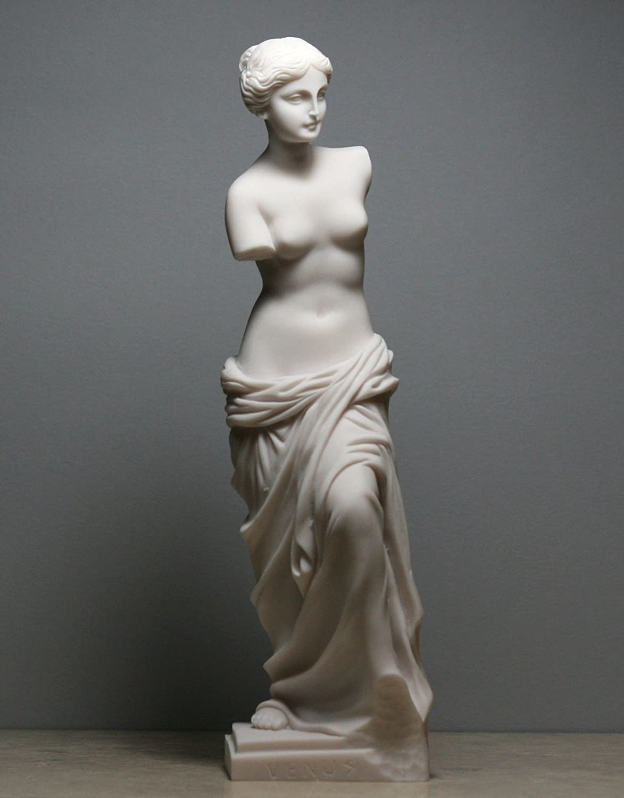
SCULPTURE

Slide 17
GRAFFITI

Slide 18
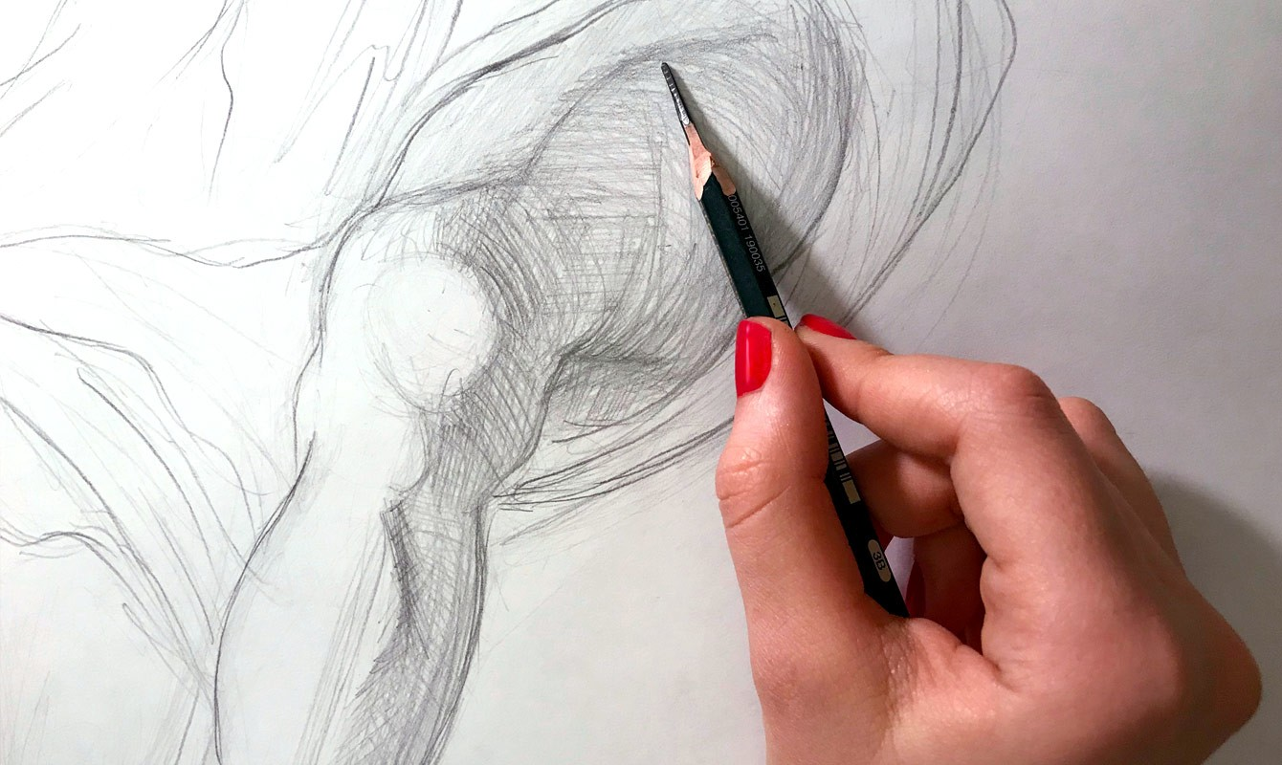
SKETCH

Slide 19
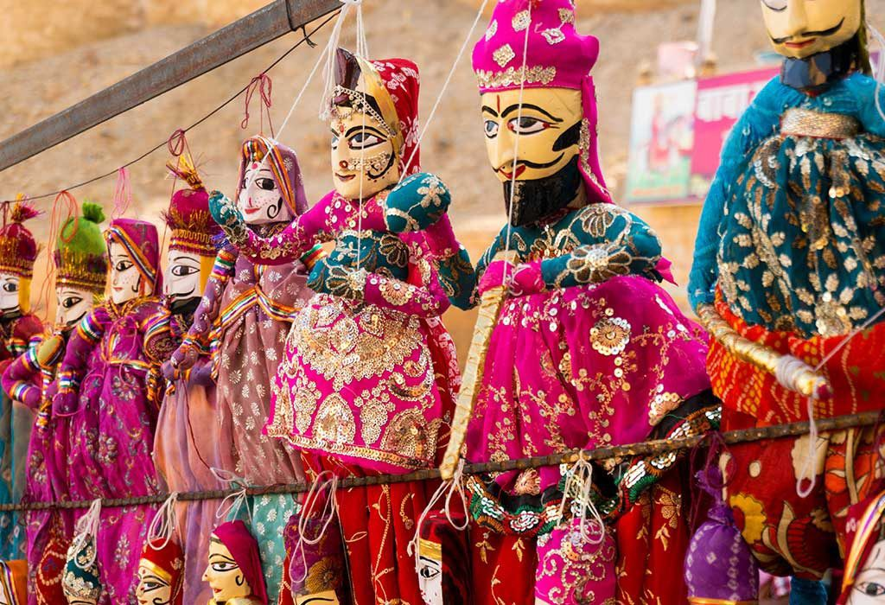
HANDICRAFT

Slide 20
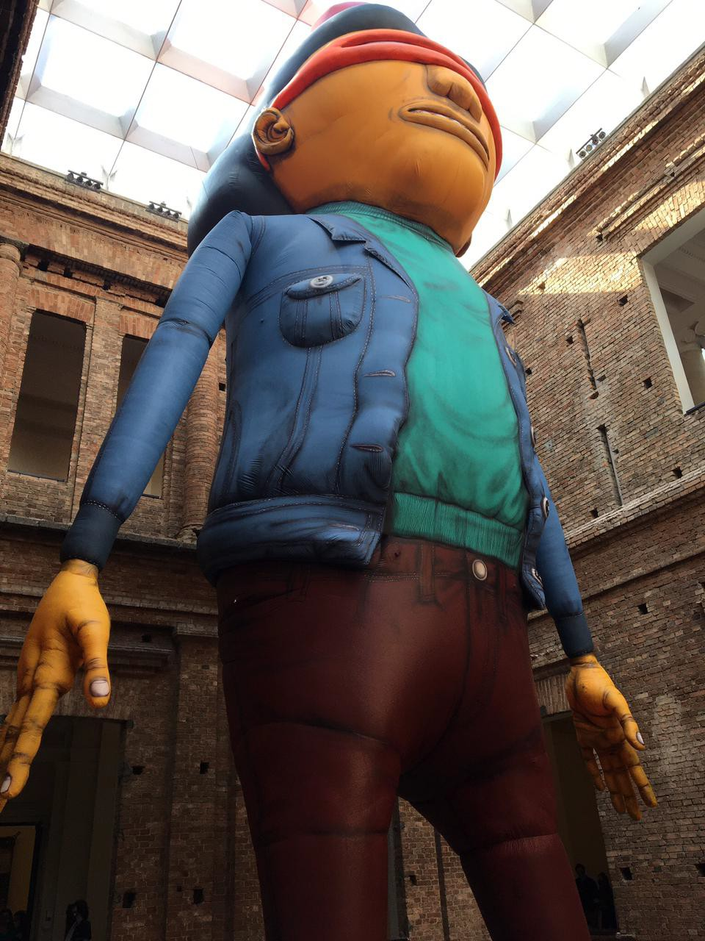
INSTALATION

Slide 21
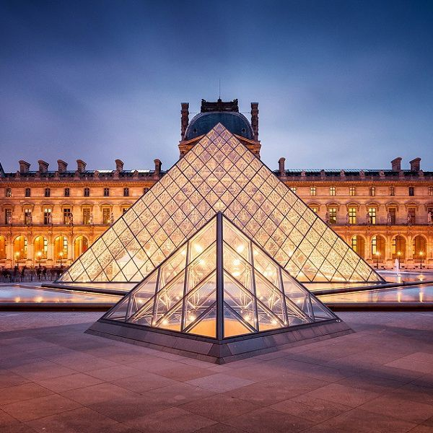
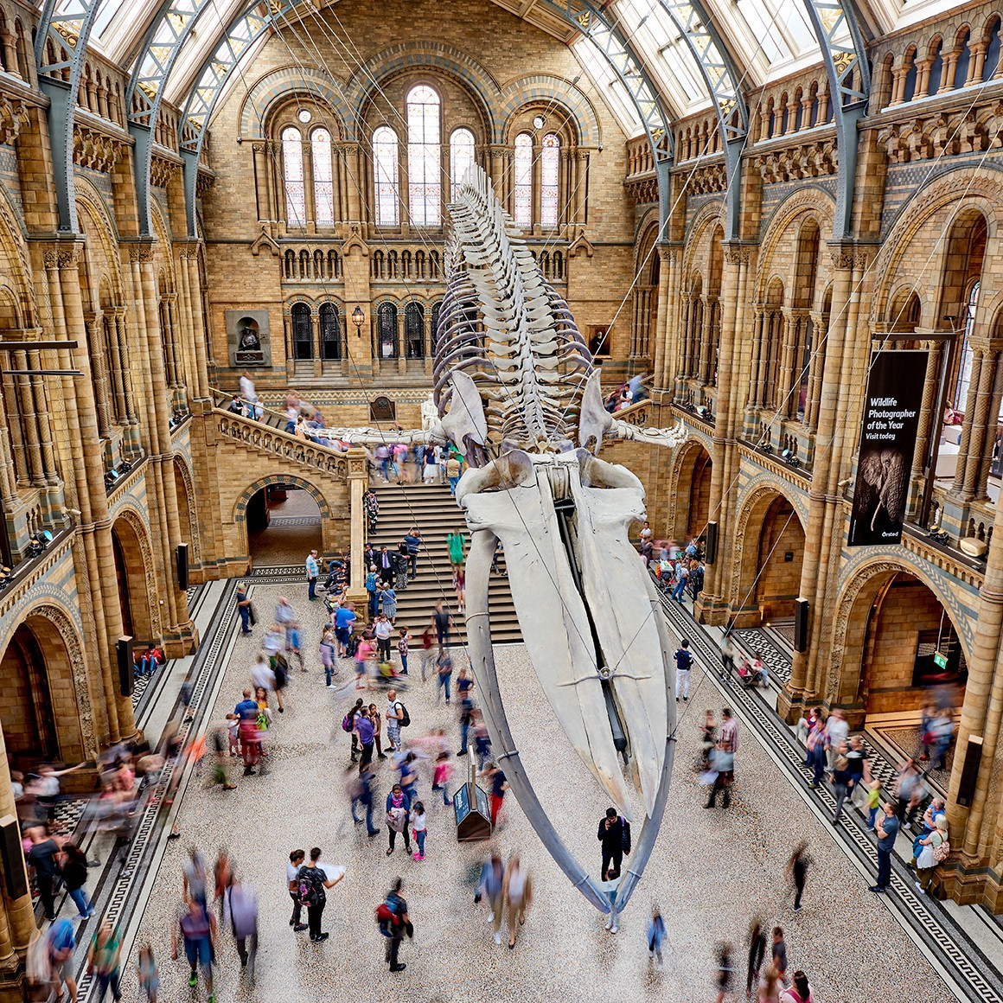
MUSEUMS

Slide 22
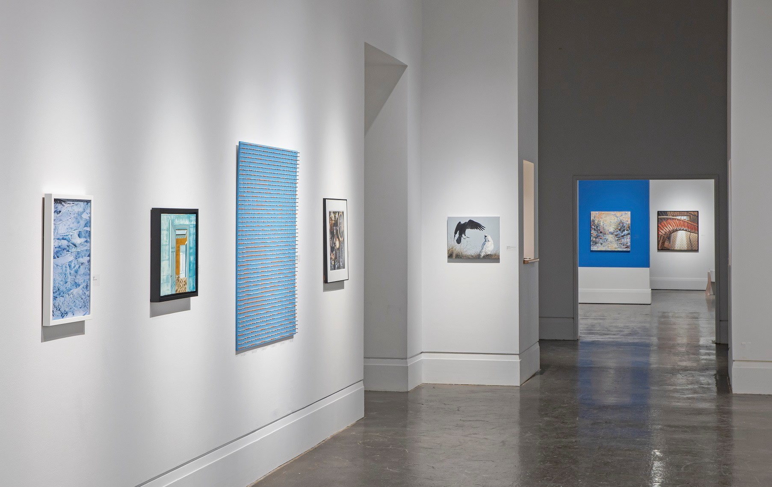
ART GALLERY

Slide 23
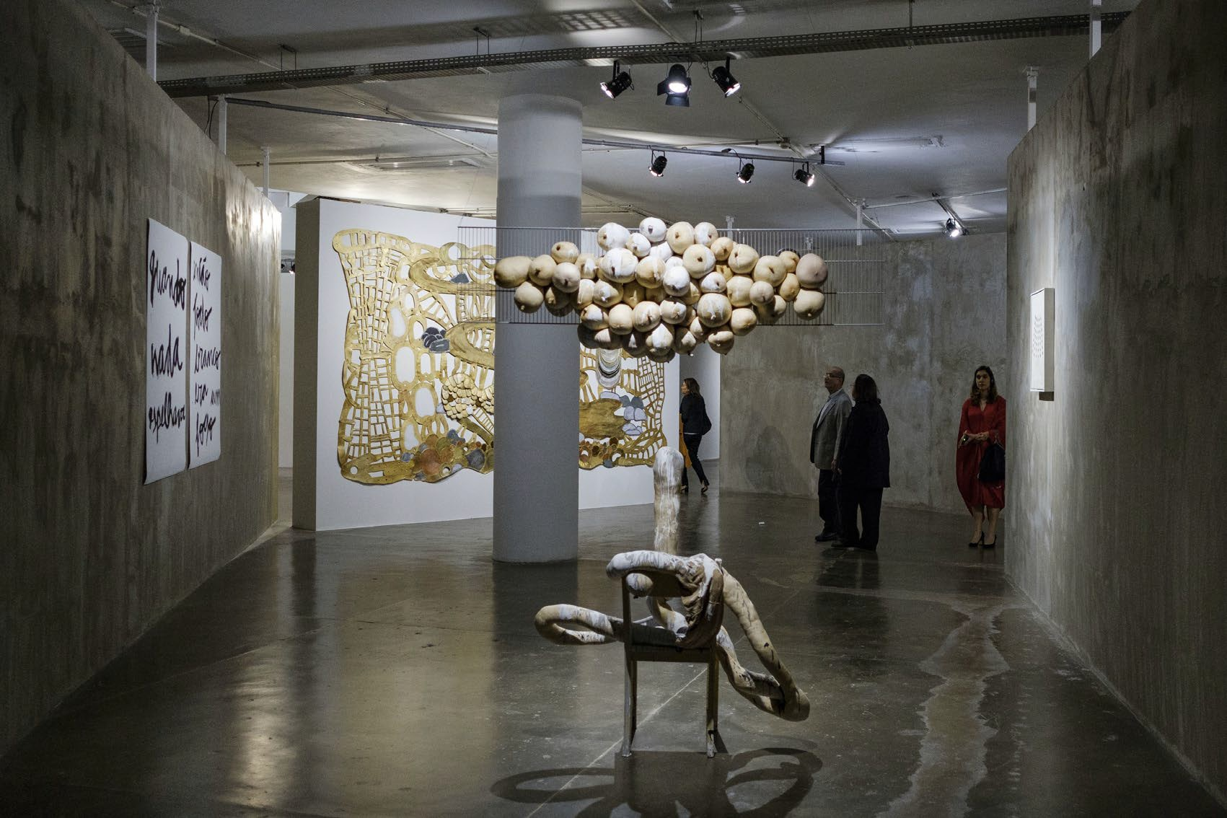
EXHIBITION (TEMPORARY)
COLLECTION (PERMANENT)

Slide 24
COLORS - COLOURS

Slide 25
LISTEN AND REPEAT

Slide 26
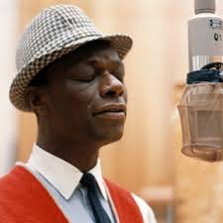
Mona Lisa, Mona Lisa, men have named you You're so like the lady with the mystic smile
Is it only 'cause you're lonely they have blamed you? For that Mona Lisa strangeness in your smile?
Do you smile to tempt a lover, Mona Lisa? Or is this your way to hide a broken heart?
Many dreams have been brought to your doorstep They just lie there and they die there
Are you warm, are you real, Mona Lisa?
Or just a cold and lonely lovely work of art?
NAT KING COLE
Do you smile to tempt a lover, Mona Lisa? Or is this your way to hide a broken heart?
Many dreams have been brought to your doorstep They just lie there and they die there
Are you warm, are you real, Mona Lisa?
Or just a cold and lonely lovely work of art?
Mona Lisa, Mona Lisa

